Slide 1
🧩 Understanding the Database Schema – DevTinder App
How users, chats, messages, and connection requests are structured in MongoDB

Slide 2
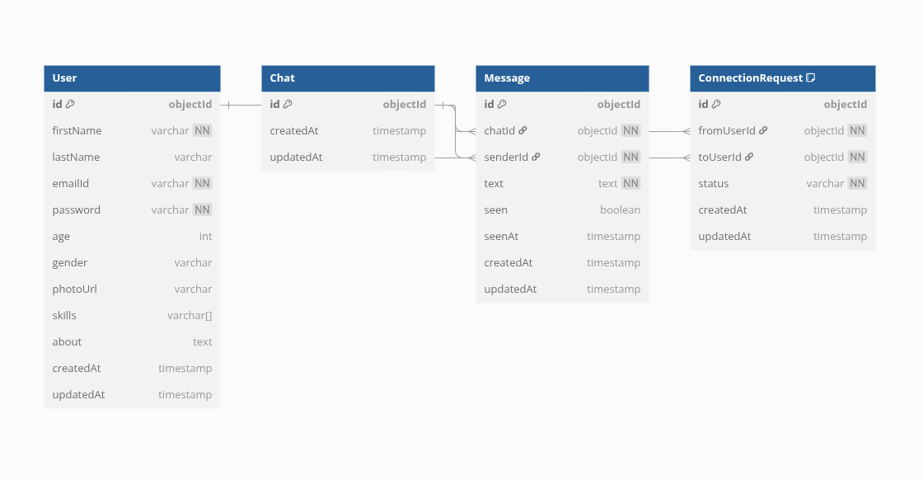

Slide 3
👤 User Schema
Stores basic user information
- Fields:
- firstName, lastName, emailId (unique)
- password, age, gender, skills, about, photoUrl
- Auto-generated timestamps: createdAt, updatedAt
- Methods:
- Generate JWT tokens
- Validate password using bcrypt
Key Point:
Each user has a unique ID used to reference them across the system.

Slide 4
🤝 ConnectionRequest Schema
- Represents swipe or match logic (like Tinder)
- Fields:
- fromUserId (User who sends request)
- toUserId (User who receives it)
- status: ["ignored", "interested", "accepted", "rejected"]
- Unique constraint on (fromUserId, toUserId)
- Validation prevents self-requests
Key Point:
Connects two users via a request with a status field.

Slide 5
💬 Chat Schema
- Represents a private chat between two users
- Fields:
- participants: Array of two user IDs
- messages: Embedded documents (array of Message schema)
Note:
You may later refactor messages into a separate collection for performance.

Slide 6
📨 Message Schema
- Embedded inside Chat OR as a separate collection
- Fields:
- senderId (User who sent it)
- text, seen, seenAt
- Auto timestamps: createdAt, updatedAt
Key Point:
Each message links to its sender and the chat it belongs to.

Slide 7
🔗 Entity Relationships
- User ↔ ConnectionRequest: via fromUserId and toUserId
- User ↔ Message: via senderId
- Chat ↔ Message: via chatId (if using separate Message model)
- User ↔ Chat: via participants array
Key Point:
MongoDB uses ObjectId references to establish relationships between documents.

Slide 8
📈 Example User Journey
1. User A sends a ConnectionRequest to User B
2. If accepted, a Chat is created with both as participants
3. Messages are sent and stored in Chat.messages or separate Message collection
4. Each message tracks sender, seen status, and timestamps

Slide 9
🚀 Scalability Ideas
- Move messages to a separate collection
- Add indexes to frequent queries (email, participants)
- Use Redis for real-time message notifications
- Use pagination for chat history (infinite scroll)

